Slide 1





Welcome to…
DESERT OASIS HEALTHCARE
As a member of the desert community
for over 35 years, Desert Oasis Healthcare
is dedicated to the health and well-being
of our neighbors throughout the
Coachella Valley.

Slide 2

PHARxM™ PULMONARY MANAGEMENT:
A Decade in the Making

Slide 3
PROGRAM OBJECTIVES
Program for the intensive and long term management of COPD, Asthma, Pulmonary Emphysema, Pulmonary Fibrosis, and Pulmonary Nodules
Achieved through comprehensive medication management under a collaborative practice protocol approved via QIC
Goals
Patient adherence to medications
Reduction in all cause and disease specific utilization and reutilization
Coordination of care and engagement with DOHC
Reduction in specialty visits
Methods
Face to face visits
Virtual visits with the use of RPM (remote patient monitoring devices)
Intensive education including a respiratory therapist
Rescue Packs

Slide 4
DATA
The Objective: Investigate whether Chronic Obstructive Pulmonary Disease (COPD) patients enrolled in the MMPULM program experienced changes in their pulmonary-related utilizations, length of stays, cost of care, and medication adherence, compared to their pre-enrollment status.
We initially started out with all COPD patients from 01/01/2011-12/31/2022 and all their respective utilizations during that time.
We then filtered out only those who were in MMPULM.
From there we narrowed down to only those patients who had at least 365 days in MMPULM continuously starting from their first Open Date.
This is the patient cohort we used for the study.

Slide 5
POPULATION SIZE
Total number of patients touched over time:
3, 477
1 pharmacist: 150-200 patients
Study N= 997 patients
7247 Utilizations
779 Pulmonary Related Admits
305 Deceased

Slide 6
DECEASED
84: Patient deaths with MMPULM open
61: Patient deaths with MMPULM open and no hospice or PC
221: Patient deaths after MMPULM case closed
7: Patient deaths with PC case open = 7
171: Patient deaths with hospice case open = 171
56% of all those in the cohort died on hospice

Slide 7
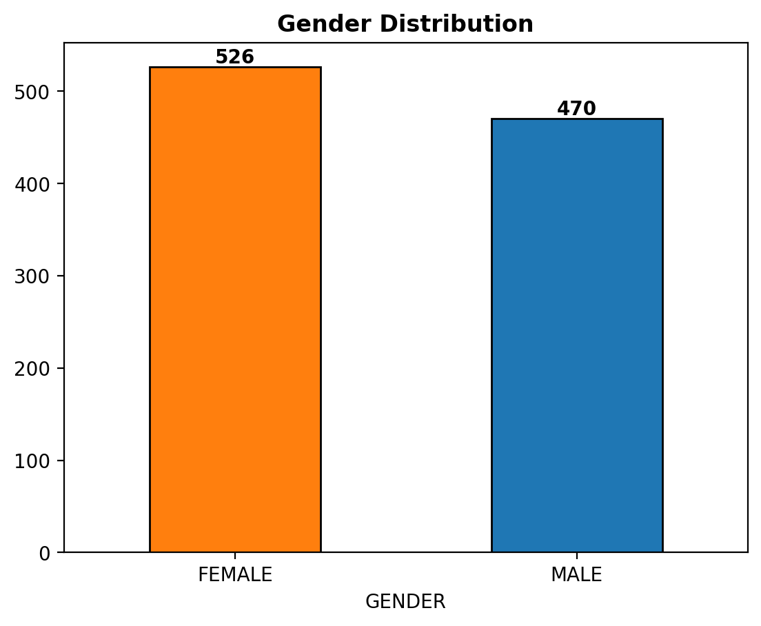
GENDER DISTRIBUTION

Slide 8
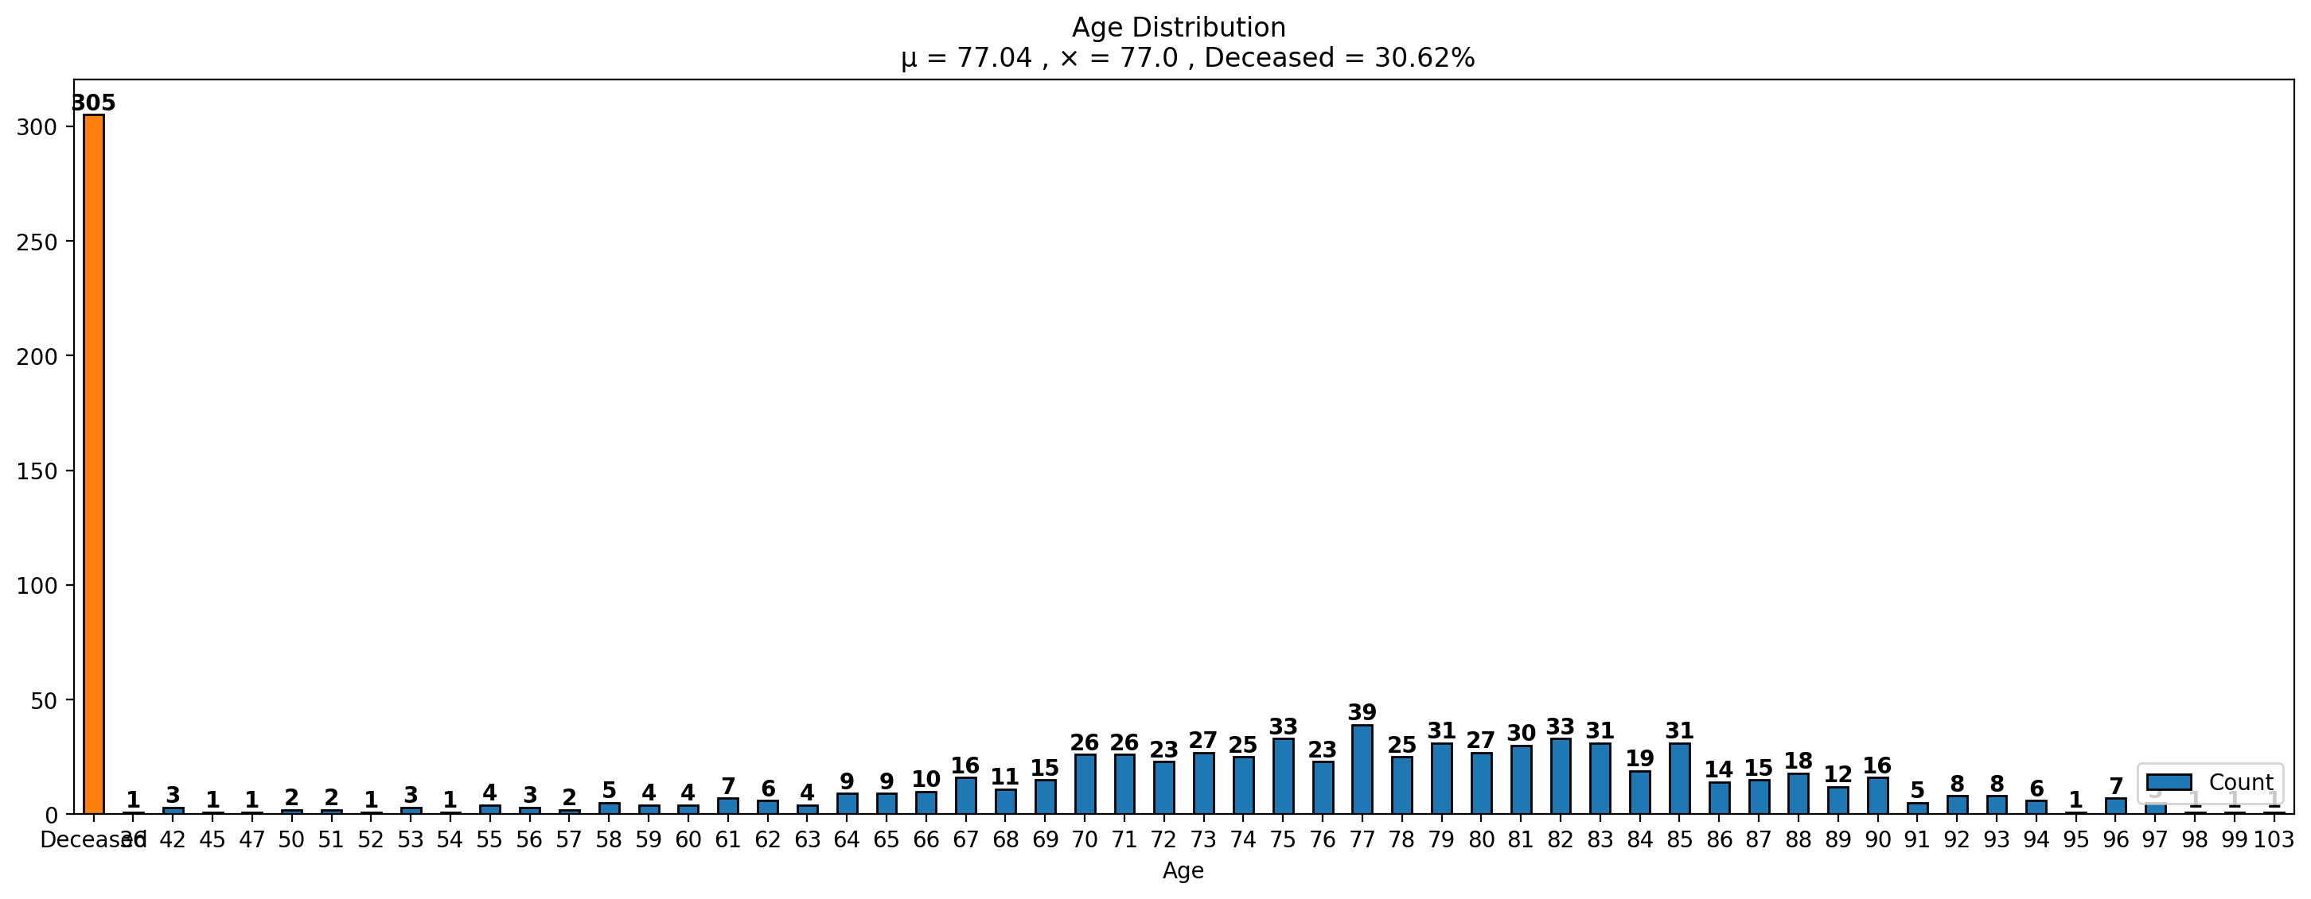
AGE DISTRIBUTION

Slide 9
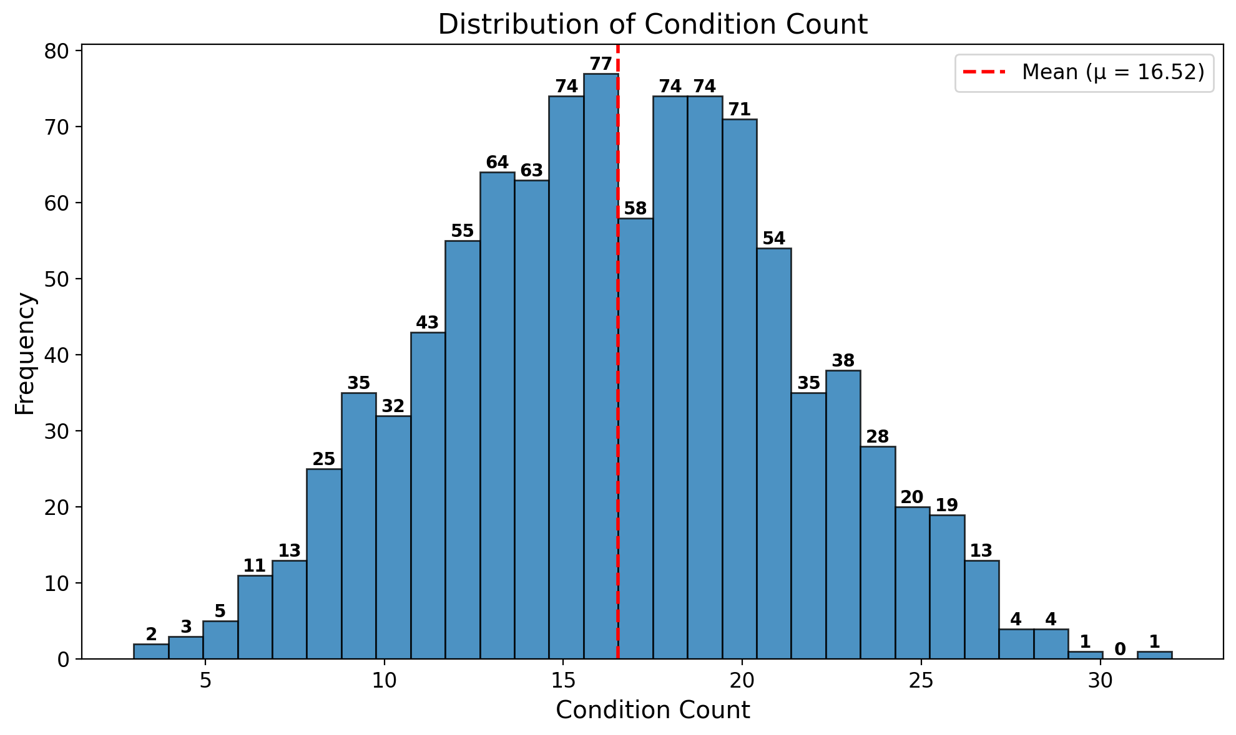
CONDITION COUNT

Slide 10
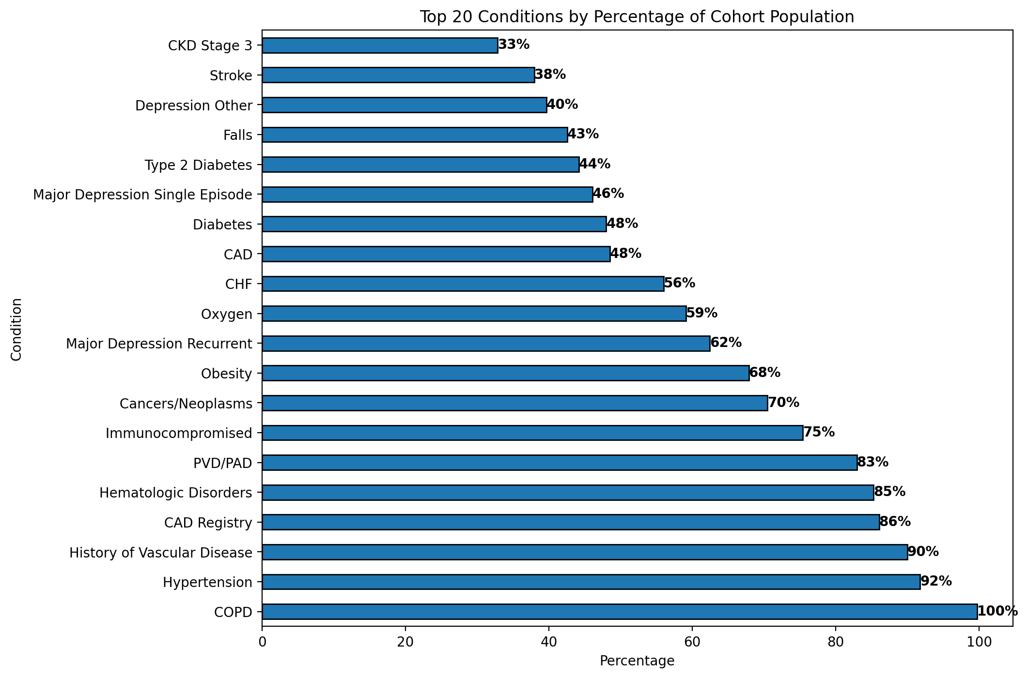
TOP 20 CONDITIONS

Slide 11
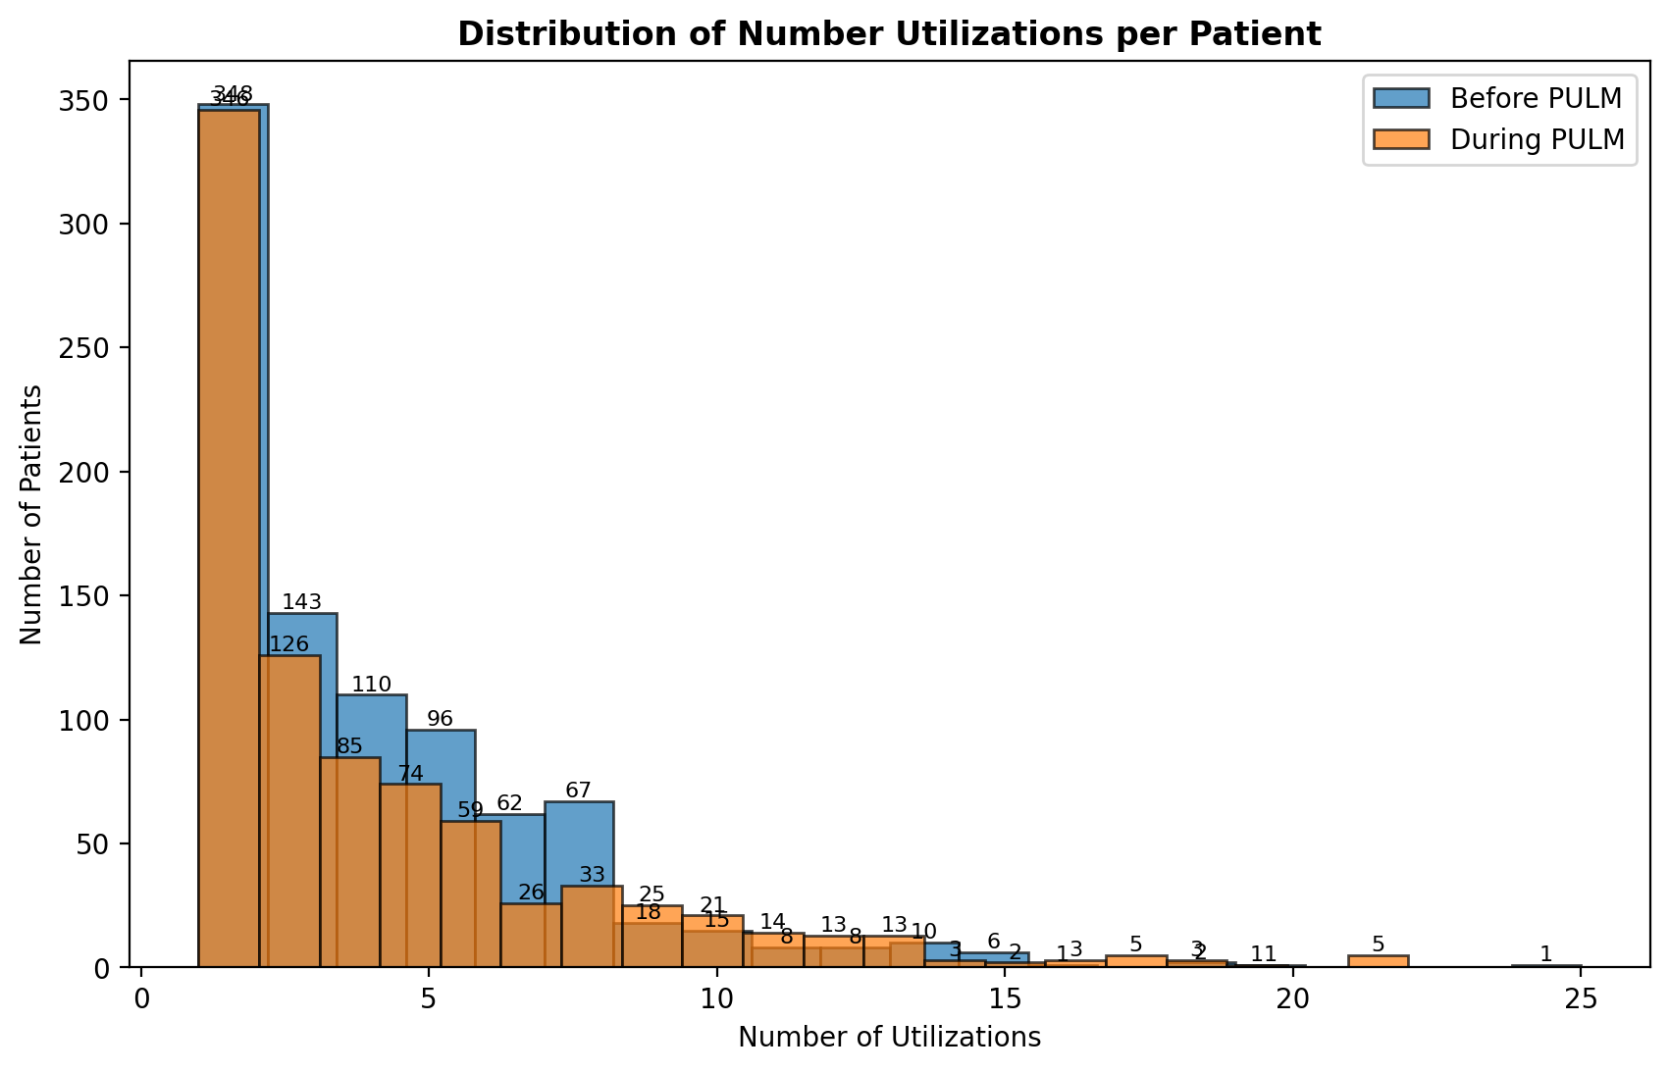
DISTRIBUTION OF UTILIZATIONS

Slide 12
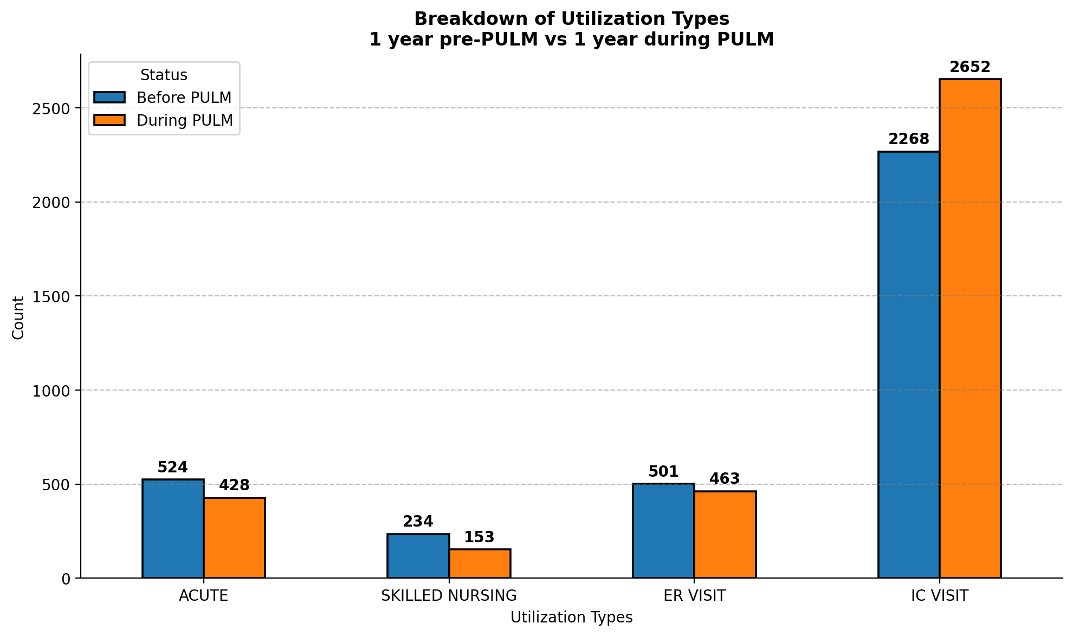
TOTAL UTILIZATIONS

Slide 13
STATISTICAL TESTING:
T-Test / Paired T-Test
A paired t-test, also known as a dependent samples t-test, is a statistical hypothesis test used to determine if there is a significant difference between the means of two related groups or conditions, where the data within each group is not independent. It is specifically designed to compare the means of paired or matched observations, such as measurements taken from the same subjects before and after an intervention. The paired t-test assesses whether the observed differences between the paired values are statistically significant or likely to have occurred by chance. If the p-value associated with the test is less than a chosen significance level (e.g., 0.05), it indicates a significant difference, while a larger p-value suggests no significant difference. The paired t-test is commonly employed in research and analysis to evaluate the impact of interventions, treatments, or changes over time within the same subjects.
To evaluate the effectiveness of an intervention or treatment by comparing measurements taken before and after the intervention. In this case, assessing whether a new program leads to a significant change in patients' health/utilization and medication adherence outcomes.
Source for used t-test : scipy.stats.ttest_rel — SciPy v1.11.3 Manual

Slide 14
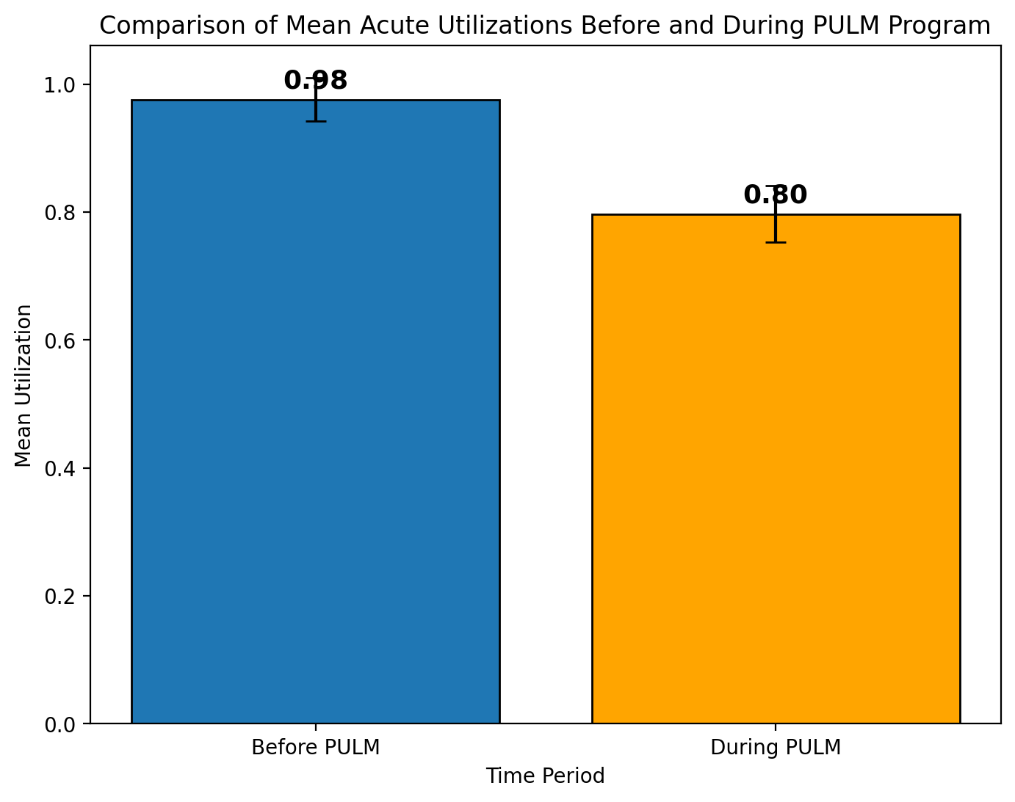
ACUTE UTILIZATIONS
Two-sided t-test result: p-value = 0.0027
One-sided t-test result (lower tail): p-value = 0.0014
T-statistic: 3.0137
Interpretation:
The p-values from both one-sided and two-sided tests are less than 0.05.
Therefore, we reject the null hypothesis that the mean number of acute utilizations before MM PULM and during MM PULM are equal.
There is strong statistical evidence within a 99% confidence interval shows that acute utilizations were reduced during MMPULM compared to before MMPULM.

Slide 15
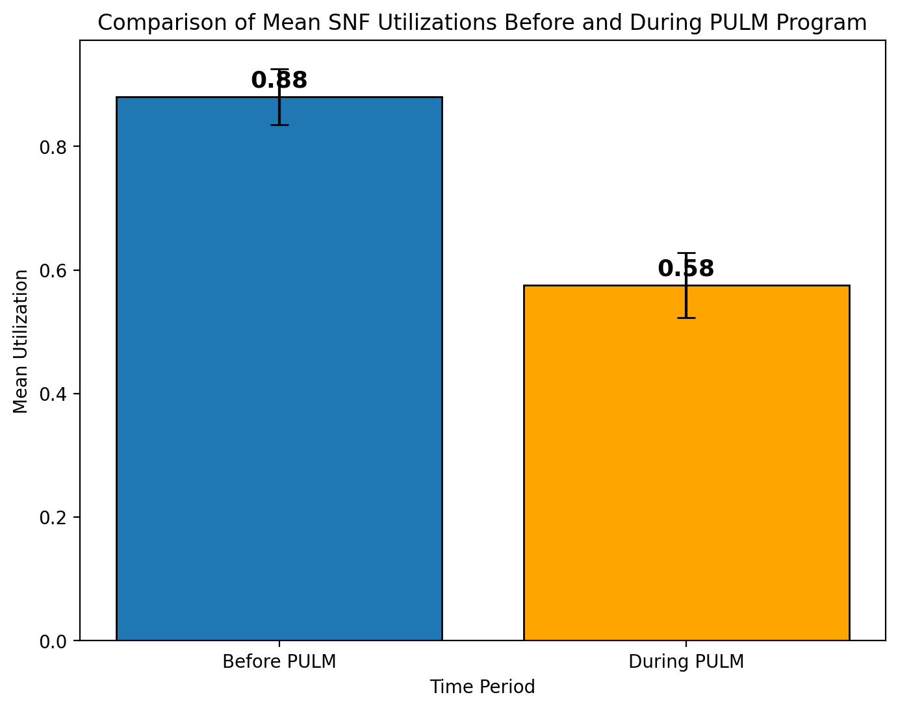
SNF UTILIZATIONS
Paired t-test Result: p-value = 0.0000457
The p-value is approximately 0.0000457, indicating strong statistical significance.
The T-statistic is: t-stat = 4.15
The t-statistic is approximately 4.15, further supporting the statistical significance.
Interpretation:
There is a statistically significant difference in SNF (Skilled Nursing Facility) utilizations before and during the program with 99% Confidence Interval.
The data suggests that the program has had a significant impact on reducing SNF utilization.

Slide 16
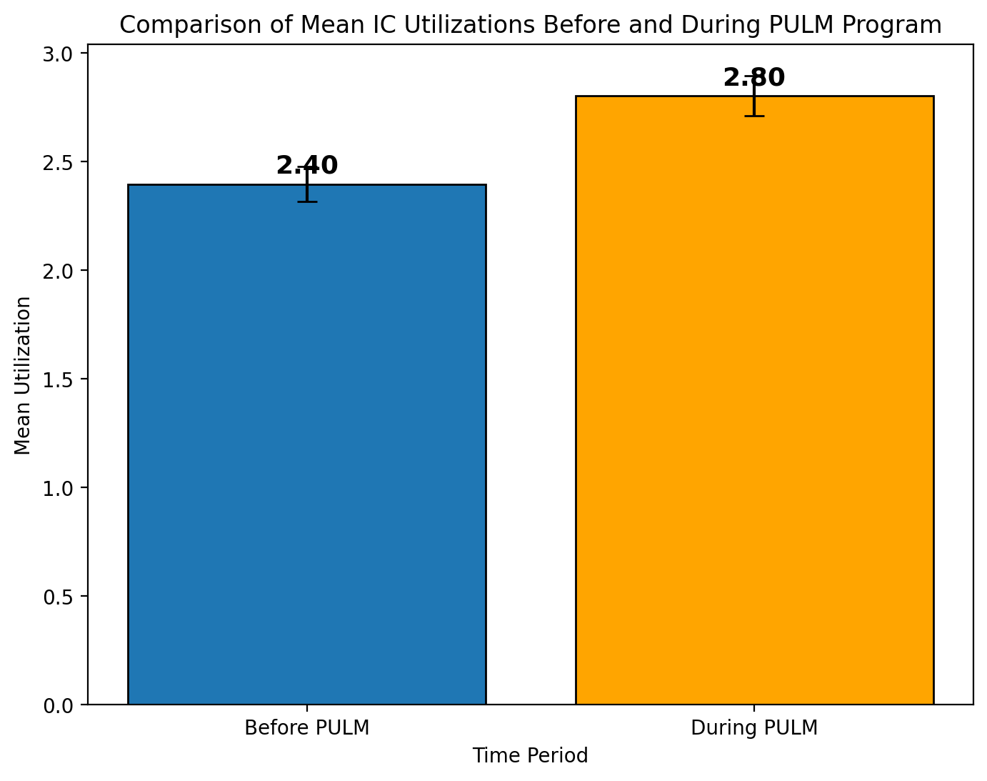
IC UTILIZATIONS
Paired t-test Result: p-value =0.0000371
The p-value is approximately 0.0000371, indicating strong statistical significance.
The T-statistic is: t-stat = -4.14
The t-statistic is approximately -4.14, further supporting the statistical significance.
Interpretation:
There is a statistically significant difference in UC (Urgent Care) utilizations before and during the program within a 99% Confidence Interval.
The data suggests that the program has had a significant impact on UC utilization, with a increase observed.

Slide 17
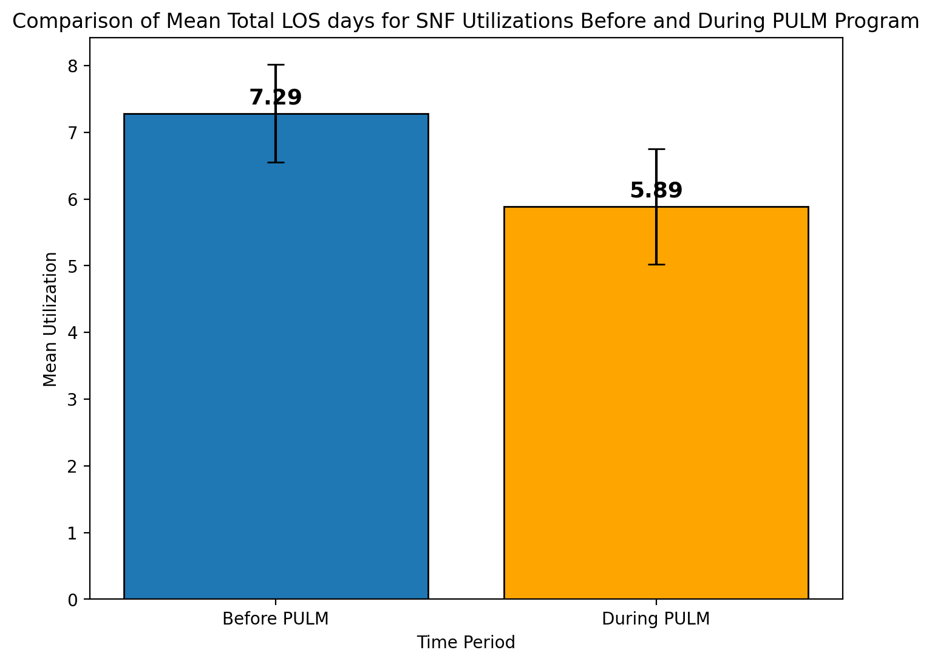
TOTAL LOS FOR SNF UTILIZATIONS
Paired t-test Result: p-value = 0.09
The T-statistic is: t-stat = 1.343
There is no statistically significant difference in Total LOS days for SNF Utilizations before and during the program

Slide 18
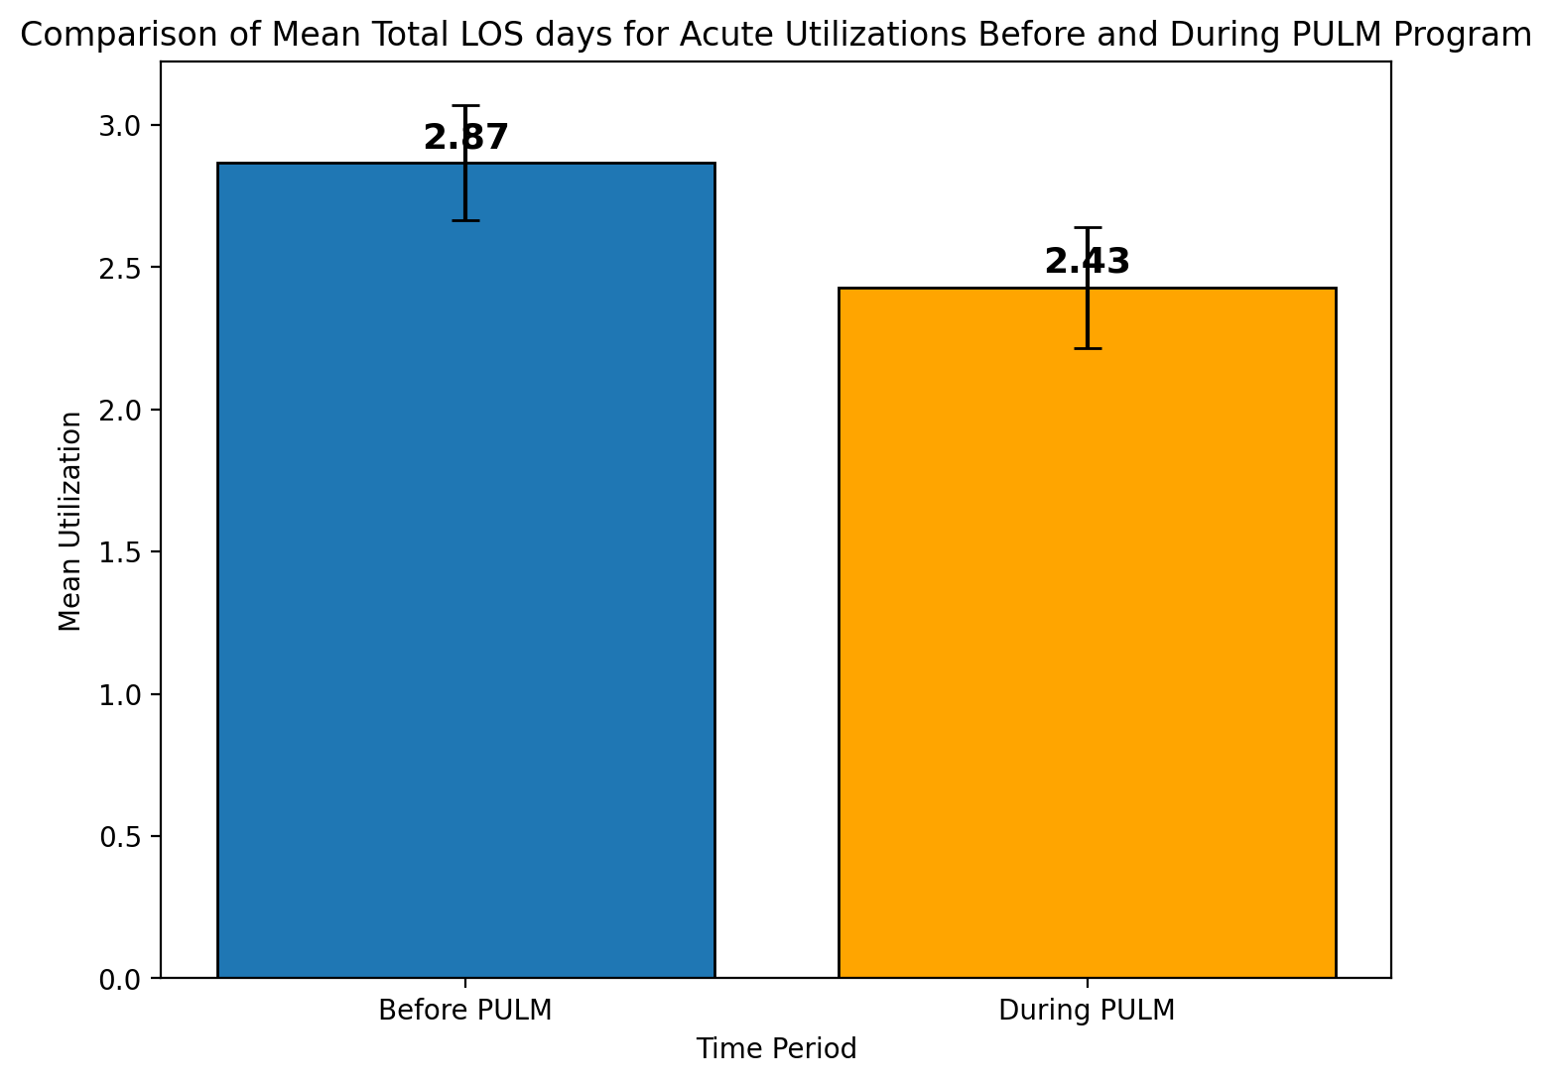
TOTAL LOS FOR ACUTE UTILIZATIONS
Paired t-test Result: p-value = 0.0691
The T-statistic is: t-stat = 1.4847
Interpretation:
There is no statistically significant difference in Total LOS (Length of Stay) Days for Acute Utilizations before and during the program.

Slide 19
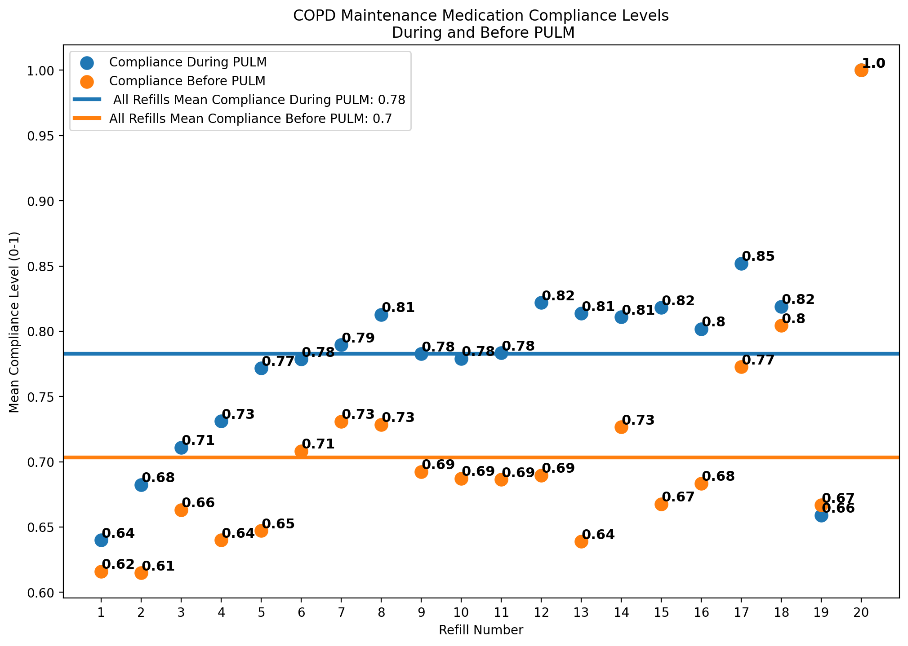
MAINTENANCE MEDICATION ADHERENCE
Medication Refill Compliance Formula:
If the patient refilled their medication within n or less to n+10 days, they are considered 100% compliant (1.0).
If they refilled >n+10 days but <= n+20 days, they are 75% compliant (0.75).
If they refilled >n+20 days but <= n+30 days, they are 50% compliant (0.50).
If they refilled >n+30 days but <= n+60 days, they are 25% compliant (0.25).
If they refilled > n+60 days but < n+90 days, they are 10% compliant (0.10).
If they refilled > n+90 days, or no refill they are 0% compliant (0).

Slide 20
MAINTENANCE MEDICATION ADHERENCE
Consistent adherence to prescribed medications plays a pivotal role in enhancing the health outcomes of individuals with Chronic Obstructive Pulmonary Disease (COPD).
reduced symptoms
decreased frequency of exacerbations
overall improved disease control
Adherence to essential medications, such as bronchodilators and inhaled corticosteroids, contributes significantly to maintaining respiratory function and enhancing the quality of life for COPD patients.
According to our data COPD Maintenance Medication adherence on average was better during MMPULM compared to before MMPULM.
https://jcsm.aasm.org/doi/10.5664/jcsm.10196
Medication adherence as a predictor of 30-day hospital readmissions - PMC.

Slide 21
RESCUE INHALER AND RESCUE PACK REFILLS

Slide 22
UTILIZATION OF RESCUE AND ANTIBIOTIC RXS

Slide 23
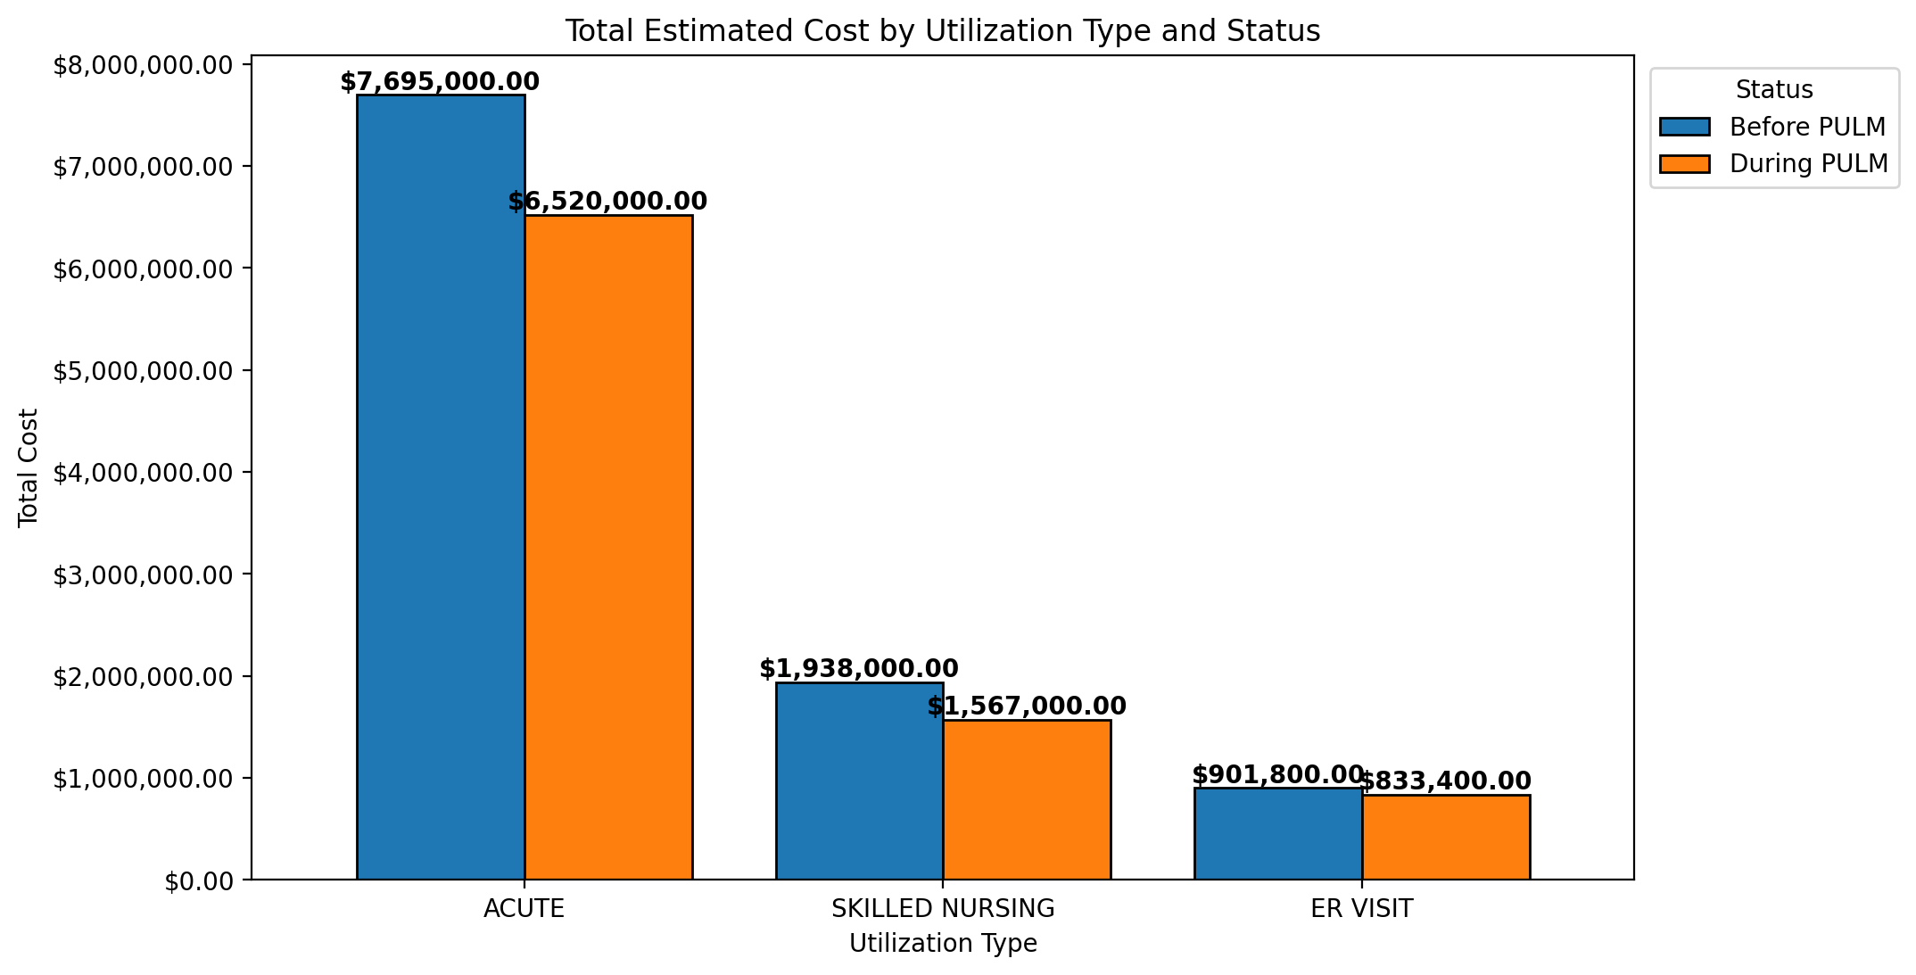
TOTAL ESTIMATED COST
$1,614,400 Total Estimated Cost Saved 1 year during PULM vs 1 year before PULM

Slide 24
CONCLUSION
In summary:
Statistically significant reduction in SNF and Acute Utilizations during MMPULM enrollment(99% Confidence Interval) compared to prior to MMPULM enrollment.
Statistically significant increase in IC Utilizations during MMPULM enrollment compared to prior to MMPULM enrollment (99% Confidence Interval).
Improved Maintenance Medication Compliance rates and decreased average Rescue and ABX Medication Refills during MMPULM compared to the Before MMPULM.

Slide 25
CONCLUSION
Cost containment:
$1,614,400 Total Estimated Cost Saved 1 year during MMPULM vs 1 year before MMPULM
Staff yearly cost $615,680
3 FTE Pharmacists
1 FTE Respiratory Therapist
4 hours per day pharmacy technician
PMPM savings with MMPULM:
$83.50 PMPM

Slide 26
OPPORTUNITIES
End of Life Discussion
Further engagement in this preliminary conversation and transition to palliative care or hospice
Greater emphasis on POLST/DPOA completion
Transition from Propeller Health (March 2024)
Rimidi opportunity
Other RPM possibilities
Churn Rates as a measure of success
Member retention as a focus

Slide 27
POST STROKE:
A Program in its Infancy

Slide 28
POST STROKE:
OBJECTIVES
To prevent the recurrence of stroke and to reduce disease-related burdens and improve quality of life and care in patients with history of stroke/TIA
Managing the individual modifiable risk factors – hypertension, diabetes, dyslipidemia, A. Fib and other hypercoagulable states, smoking, alcohol & substance abuse, sleep apnea, pro-thrombotic meds, anatomical abnormality via vascular/neuro consult (ex: carotid stenosis, PFO), etc.
Collaborating with Primary Care Provider, neurology, cardiology, PT/OT/ST, vascular surgery, optometry, behavioral health, case manager, social services, and health Education (Fall prevention, nutrition, smoking/alcohol cessation)
Patient education and lifestyle modification
Reduce reutilizations and readmissions
Reduce specialist visits through collaboration
Improve medication adherence
Improve engagement with DOHC

Slide 29
POST STROKE:
CRITERIA
INCLUSION
Utilization due to stroke / TIA within the past three years
History of stroke / TIA with one of the following criteria
Uncontrolled/refractory hypertension
Uncontrolled dyslipidemia (Not applicable to hemorrhagic stroke)
Uncontrolled diabetes (Not applicable to hemorrhagic stroke)
EXCLUSION
Age < 18 years old
Hospice patients
Patient/family declining the clinic services

Slide 30
POST STROKE:
DATA ANALYSIS
A patient registry was obtained to examine claims data to understand the Readmission rate.
Two patient populations were identified :
All patients who have stroke diagnosis (Acute Stroke Registry n=4166).
All patients that were then enrolled into the MM Stroke program (MM Stroke Population n=207).
In this presentation we will compare readmit rates for all cause utilization and stroke related utilizations for 2022 and 2023 for these populations.

Slide 31
POST STROKE:
DIAGNOSIS INCLUDED
We Identified stroke related utilizations if ER, SNF, IC, or Acute utilizations had the following Admit Diagnosis Codes:
“Stroke Related Utilizations” include any of the following diagnosis codes:
I60.xx Non-traumatic subarachnoid hemorrhage
I61.x Non-traumatic intracerebral hemorrhage
I62.0x Other and unspecified non-traumatic intracranial hemorrhage
I63.xxx Cerebral Infarction
G45.8 Other transient cerebral ischemic attacks and related syndromes
G45.9 Transient cerebral ischemic attack, unspecified
Z86.73 Personal history of transient ischemic attack (TIA), and cerebral infarction without residual deficits
Z82.3
Note that readmission numbers for stroke related utilizations are low.

Slide 32
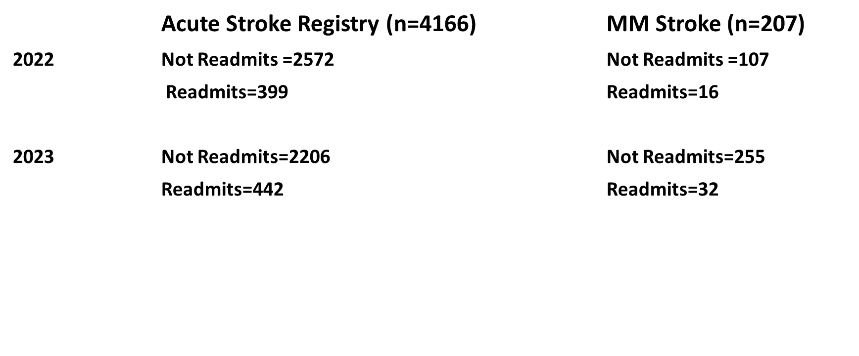
POST STROKE:
ALL CAUSE READMITS

Slide 33
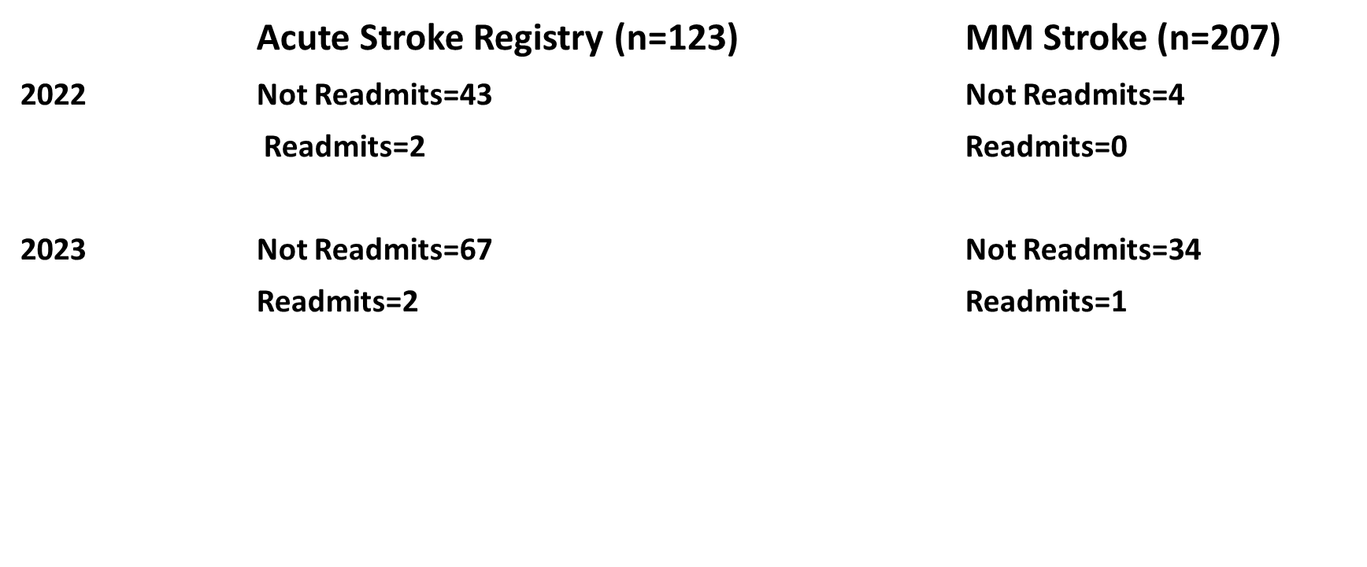
POST STROKE:
STOKE RELATED READMITS

Slide 34
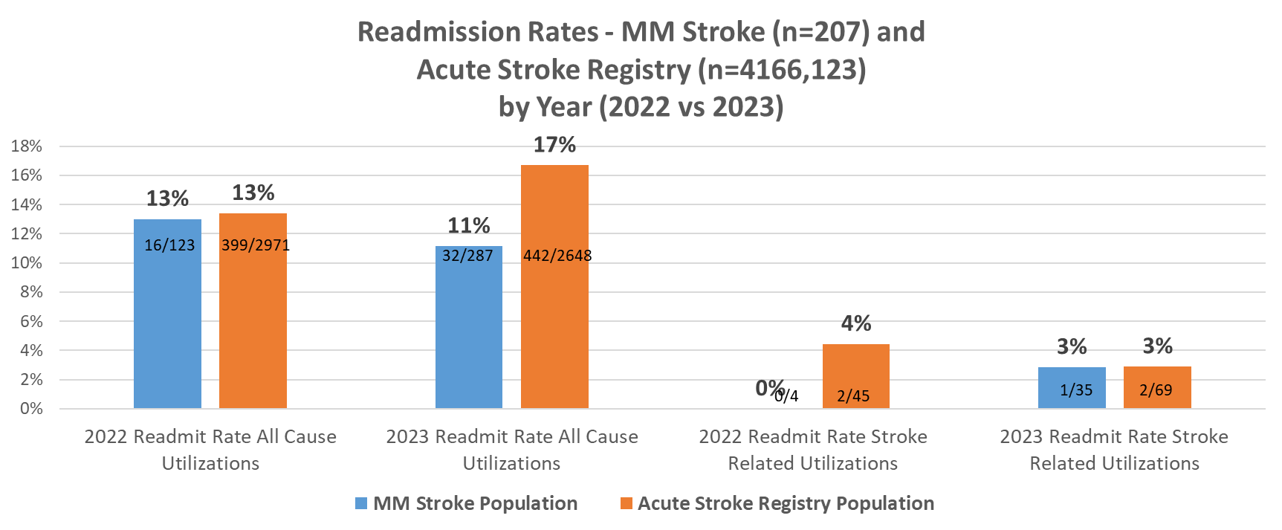
POST STROKE:
READMIT RATES
MM Stroke patients had 17 fewer readmits for all cause utilization than expected value.
The average LOS for those readmits in 2023 was 2.719. Thus the estimated cost of MM Stroke patients was saved ~ $231,115 in the first 6 months

Slide 35
POST STROKE:
AVERAGE LOS
Average LOS was 2.719 for Acute Stroke Patients 01/01/2022-YTD.
Average LOS was 2.567 for MM Stroke Patients in 01/01/2023-YTD.

Slide 36
POST STROKE:
CONCLUSION
While the numbers are currently still too low for statistical analysis, trends show reductions in all cause readmissions.
Those in the post stroke program who were admitted had a shorter length of stay likely due to better manage chronic conditions.
Initial savings offset the cost of staffing.

Slide 37
POST STROKE:
OPPORTUNITIES
Continue to trend as our enrollment increases.
Anecdotal insight from our neurology providers is positive and shows a reduction in visits allowing for better access. We need to measure this.
Patient satisfaction is very positive as they view this as a collaborative effort.
What is the impact on this program on aligned quality measures?
Apply churn rate to this program.
Enhance rates of POLST/DPOA completion.
Referral to palliative care/hospice as appropriate

Slide 38


